Slide 1
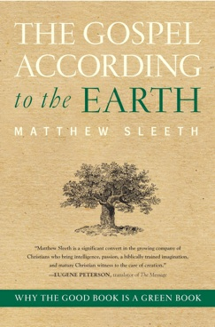
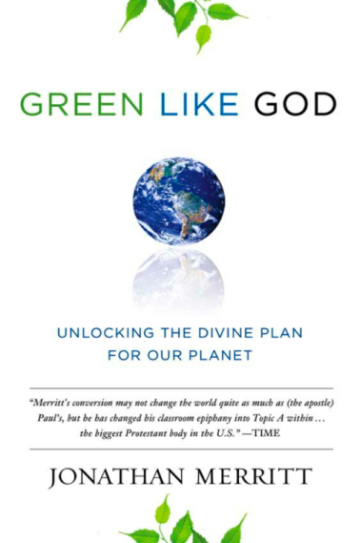
Environmentalism’s Threat to the Gospel in the Name of “Creation Care”
The gospel becomes “If you love God, take good care of the Earth,” not “Jesus Christ died for our sins, was buried, and rose again from the dead” (1 Corinthians 15:3–4). Imperative replaces indicative. Law replaces gospel.
J. Matthew Sleeth
Jonathan Merritt
Harper Collins Pub.

Slide 2
Environmentalism’s Threat to Christian Ethics: Asceticism
Colossians 2:20-23:
If with Christ you died
to the elemental spirits of the world,
why, as if you were still alive in the world,
do you submit to regulations—
‘Do not handle, Do not taste, Do not touch’
(referring to things that all perish as they are used)—
according to human precepts and teachings?
These have indeed an appearance of wisdom
in promoting self-made religion
and asceticism and severity to the body, but they are
of no value in stopping the indulgence of the flesh.

Slide 3
Environmentalism’s Threat to Biblical Authority
The Bible says we’re not supposed to be conformed to this world but
to be transformed by the renewing of our minds by the Word of God;
to test all things, hold fast what is good;
to take every thought captive to the obedience of Christ.

Slide 4
Environmentalism’s Threat to the Pro-Life Movement
Minor, unintentional risk from environmental hazards is equated with intentional death from abortion, obscuring the meaning of “pro-life.”

Slide 5
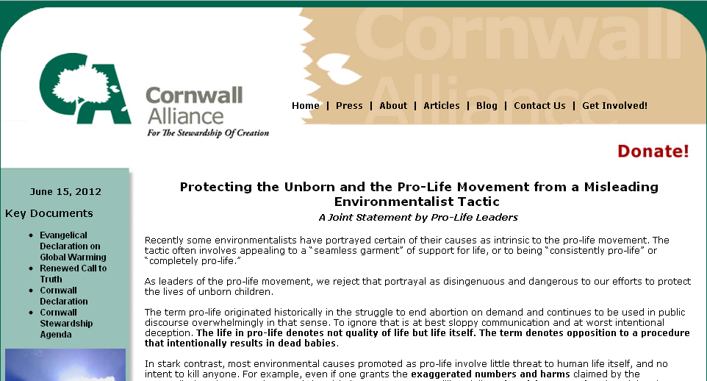
Pro-Life Leaders Fight Back

Slide 6
A Call to Spiritual Arms for Spiritual Warfare
We face the prospect of
an increasingly powerful U.N.,
dominated by pagan religionists,
backing an agenda for global wealth redistribution,
engineered and enforced by global government,
justified by the need to avert a global environmental crisis,
belief in which depends not on real science but on irrational, mystical, post-normal science,
used to intimidate a gullible world into submission to
a comprehensive worldview that is anti-Christian and, ipso facto, anti-real science.

Slide 7
What Can You Do?
Know and Teach the Word.
Do the Word.
Pray.

Slide 8
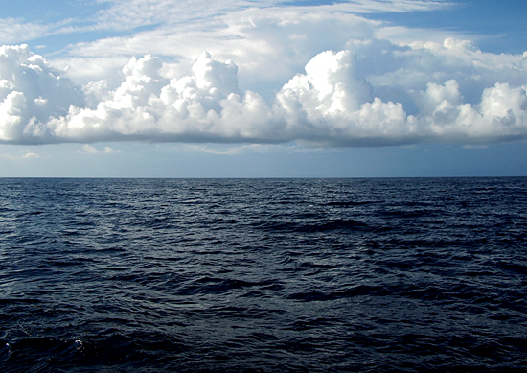
Job 38:9—God made clouds a “garment for the sea.”
Clouds’ effect on Earth’s surface temperature is important to debate over global warming.
Is it positive, increasing warming or cooling? Or negative, decreasing warming or cooling?

Slide 9
“Climate Sensitivity”
“Climate sensitivity” = how much Earth’s average surface temperature would rise because of doubled CO₂ concentration, after climate feedbacks.
But Earth’s average surface temperature with no greenhouse effect would be about 0 degree;
with the greenhouse effect but no feedbacks, about 140 degrees;
with the greenhouse effect and feedbacks, it’s about 59 degrees.
That means feedbacks reduce greenhouse warming 58%.
Basic physics tells us that doubling CO₂ concentration would raise Earth’s average surface temperature by about 2.1 degrees.
To reach IPCC’s 5.4-degree midrange claim, feedbacks would have to multiply that warming by 250 percent.
Real “climate sensitivity” is only about nine-tenths of a degree and thus not dangerous.

Slide 10
Some Concrete Actions
“Adopt a Highway”
Neighborhood Cleanup
Neighborhood Gardens
Insulating Homes and Churches
Sensible recycling
Supporting or Volunteering with Ministries that Help the Poor in East Africa; e.g. www.cvtogether.org
Participating in Sensible Recycling Programs
Studying and Teaching Biblical Earth Stewardship
Praying for and supporting the Cornwall Alliance with online donations at www.CornwallAlliance.org

Slide 11
Wake-Up Calls
Four Profound Books
Two Profound Movies

Slide 12
www.CornwallAlliance.org
Who are we? A coalition of theologians, pastors, scientists, economists, and policy experts committed to promoting environmental stewardship and economic development built on Biblical principles.
What is our mission? We seek to magnify
the glory of God in creation,
the wisdom of His truth in environmental stewardship,
the kindness of His mercy in lifting the needy out of poverty,
and the wonders of His grace in the gospel of Jesus Christ.

