Slide 1
Witnessing for Christ in a Religiously Pluralistic World: Confronting Cults and False Religions with E. Calvin Beisner
Unit 4: Godly Dominion vs. Religious Environmentalism:
Reducing Poverty, Restoring Liberty, and Renewing Human Dignity
by Reclaiming the Blessings of Genesis 1:28

Slide 2
Who said this, and where does he live?
Population growth is the key causative of climate change and its negative impacts. Unless we [adopt a] multi-faith approach to sensitizing our people on the dangers of careless population growth, we [will lose] the climate change fight. We must tell our people to control human procreation …..

Slide 3
Memories of My Indian Childhood
The beauties of God’s creation
The horrors of poverty, hunger, and disease

Slide 4
Books by E. Calvin Beisner

Slide 5
Genesis 1:28
“God blessed them. And God said to them, ‘Be fruitful and multiply and fill the earth and subdue it and have dominion over the fish of the sea and over the birds of the heavens and over every living thing that moves on the earth.’”

Slide 6
Biblical Environmental Stewardship
… looks like people made in the image of God, reflecting God’s own creativity, working together to enhance the fruitfulness, beauty, and safety of the Earth, for the glory of God and the good of our neighbors, thus tying together the two Great Commandments to love God and love our neighbor.

Slide 7
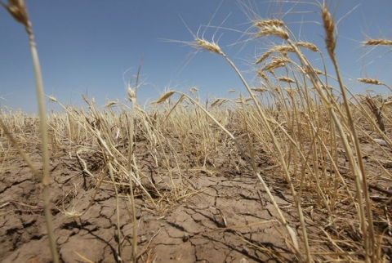
Godly Dominion’s Effect on Wheat Yields
A drought-stricken
wheat field in Texas
illustrates typical wheat yield
throughout history until two centuries ago.
Today’s normal wheat field yields 200 times as much crop per seed.

Slide 8
What’s Wrong with Calling Ourselves Environmentalists?
Historically: from conservationism through preservationism to environmentalism.
Etymologically: environment = surroundings = everything; the inherent totalitarian tendency of environmentalism.
Biblically: preferring Biblical terms for Biblical doctrines and activities.
Why not Biblical Earth stewardship or godly dominion?

Slide 9
Genesis 1:27: The Essence of Man
“God created man in his own image, in the image of God he created him; male and female he created them.”
Man is
the image of God;
male and female.

Slide 10
Genesis 1:28: The Mission of Man
“God blessed them. And God said to them, ‘Be fruitful and multiply and fill the earth and subdue it and have dominion over the fish of the sea and over the birds of the heavens and over every living thing that moves on the earth.’”
God’s mission for man, male and female, is twofold:
to multiply and fill the Earth; and, filling it,
to subdue and rule it.

Slide 11
Environmentalism’s Attack on Genesis 1:28
Human multiplication and human rule over the Earth are the nemeses of environmentalism.

Slide 12
How the Creation Care Movement Undermines Genesis 1:28
The undermining happens in two stages:
Wrongly interpreting Genesis 2:15
Wrongly interpreting Genesis 1:28 in light of the mistaken interpretation of Genesis 2:15.

Slide 13
From Darwinism to Environmentalism: Attacking the Dignity of Man in Two Stages

Slide 14
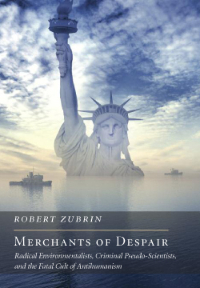
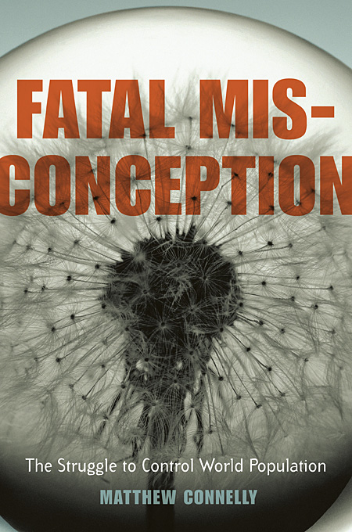
3 Key Books that Unveil the Long War on God’s Image

Slide 15
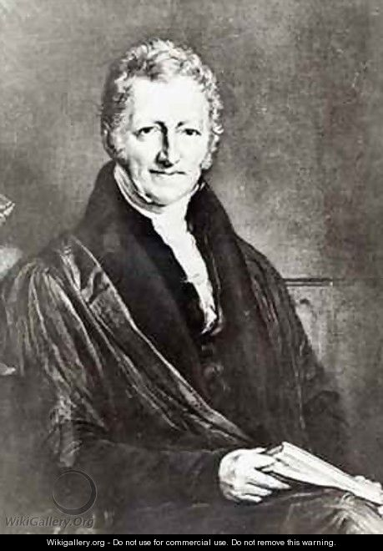
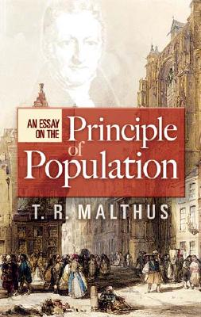
1798—Thomas Robert Malthus
An Essay on the Principle of Population incited fear of overpopulation and depletion of resources, portraying man only as consumer, not producer.

Slide 16
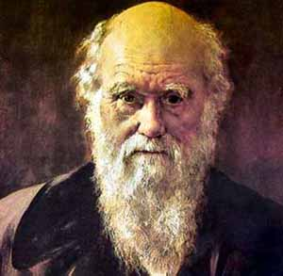
1859—Charles Darwin
On the Origin of Species by Means of Natural Selection, or the Preservation of the Favoured Races in the Struggle for Life, undermined belief in the sanctity of human life as bearing the image of God and offering “scientific” justification for racism.

Slide 17
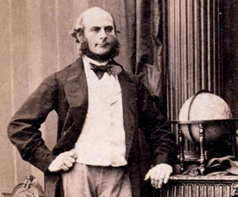
1883—Francis Galton
Inquiries into Human Faculty and Its Development launched the eugenics movement as a means for higher races (the “fit”) to weed out lower ones (the “unfit”) through population control imposed on colonies.

Slide 18
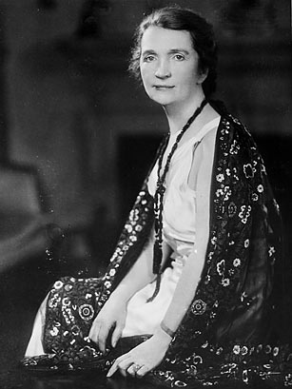
1920—Margaret Sanger
1890s–1930s, Progressives like Margaret Sanger (founder of Planned Parenthood), launching the sexual revolution of the 1910s–1920s, advocated contraception and abortion to limit population growth among the racially “unfit.” Their efforts led to government “family planning” programs, including incentivized or coerced sterilization and abortion and refusal to alleviate famines.

Slide 19
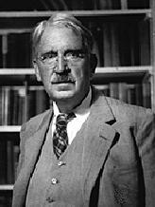
1933—John Dewey
1920s—1950s, Secular Humanists, led by John Dewey, took over America’s colleges of education and then the public schools, undermining belief that human beings are the image of God with a God-given right to life, liberty, and property.

Slide 20
1953—Hugh Hefner
1950s–1970s: The Progressives’ sexual revolution, delayed by the Great Depression and World War II, revives and, aided by new contraceptive technologies promising pleasure without consequences, became dominant, with destructive effects on marriage, family, and broader society.

Slide 21
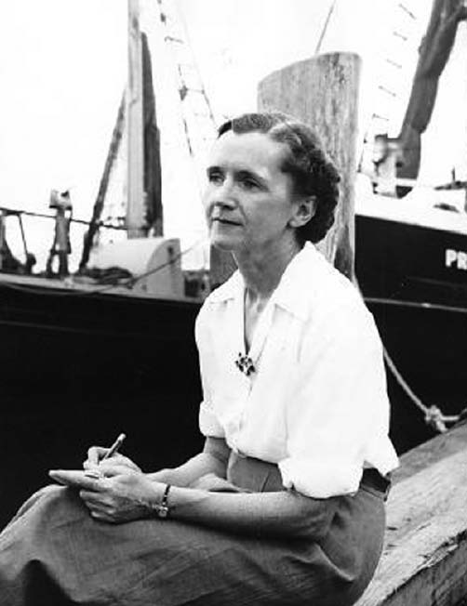
1962—Rachel Carson
Darwinist naturalist Rachel Carson publishes Silent Spring, popularizing pseudo-scientific ecological fears that come to dominate the environmental movement. One consequence: the U.S. Environmental Protection Agency bans DDT though EPA’s own scientific tests showed it safe, and the U.S. requires countries receiving foreign aid to ban it as well, leading to about 2 million malaria deaths every year in poor countries.

Slide 22
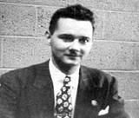
1972—Maurice Strong
1970s—2010s: The environmental movement grows to world prominence, especially with the U.N.’s Earth Summit in Rio de Janeiro (1992) the Earth Charter, the U.N. Intergovernmental Panel on Climate Change, the U.N. Framework Convention on Climate Change, Agenda 21, the International Council for Local Environmental Initiative (ICLEI), and the Kyoto Protocol; the growth of the animal rights, plant rights, and ecosystem rights movements; and demands for global governance to overcome alleged environmental crises, especially global warming.

Slide 23
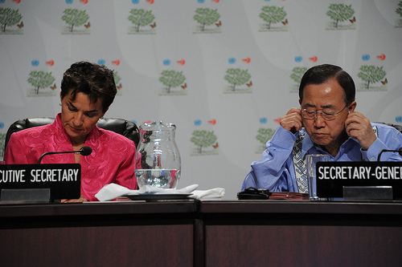
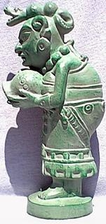
Christiana Figueres Invoked the Mayan Goddess Ixchel at COP-16 in Cancun, 2010

